Slide 1
Employee Data Analysis using Excel
STUDENT NAME: HARIPRIYA K
REGISTER NO:
DEPARTMENT: B.COM COMPUTER APPLICATION
COLLEGE: S.I.V.E.T COLLEGE,GOWRIVAKKAM,CH-600073

Slide 2
PROJECT TITLE
Employee Performance Analysis using Excel

Slide 3


AGENDA
Problem Statement
Project Overview
End Users
Our Solution and Proposition
Dataset Description
Modelling Approach
Results and Discussion
Conclusion
3/21/2024 Annual Review

Slide 4

PROBLEM STATEMENT
Validating Employee performance
Based on performance providing increment to the employee
Providing employee achievements.

Slide 5

PROJECT OVERVIEW
Analyzing the performance of employee considering various factor like gender, performance, rating, employee unit, employee id.
In order to identify the trends and patterns of different categories of employee.

Slide 6

WHO ARE THE END USERS?
Employee
Employer
Management
Various IT Sector
Industry

Slide 7
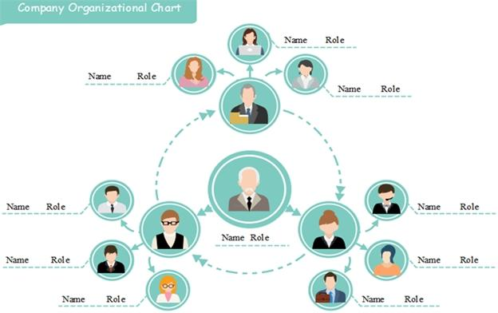

Slide 8

OUR SOLUTION AND ITS VALUE PROPOSITION
Conditional formatting-Missing
Formula-performance
=IF(L2=5, "VERY HIGH", IF(L2=4,"HIGH",IF(L2=3,"MED",IF(L2=2,"LOW",""))))
Filter –remove:
Pivot table-Summary
Graph-Data visualization

Slide 9
Dataset Description
Employee=Kaggle
26- Features
13-Features
Emp id-num
FirstName
LastName
Emp type
Performance level
Gender-male female
Employee rating –num
Bussiness Unit
LocationCode
RaceDesc
Employee Classification
EmployeeType
EmployeeStatus

Slide 10

THE "WOW" IN OUR SOLUTION
Performance level=IF(L2=5, "VERY HIGH", IF(L2=4,"HIGH",IF(L2=3,"MED",IF(L2=2,"LOW",""))))
3/21/2024 Annual Review
10

Slide 11
MODELLING
11

Slide 12
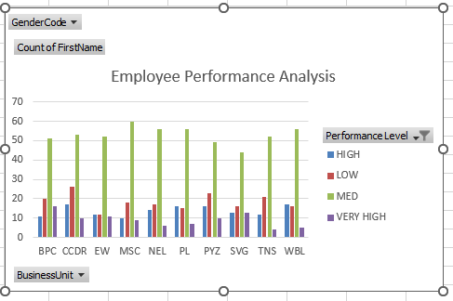
RESULTS
12

Slide 13
RESULTS
13

Slide 14
conclusion

